Slide 1

QUESTION ANSWERING
Information Retrieval System
DATA SCIENCE INTENSIVE CAPSTONE
BY: DENNIS DANG

Slide 2
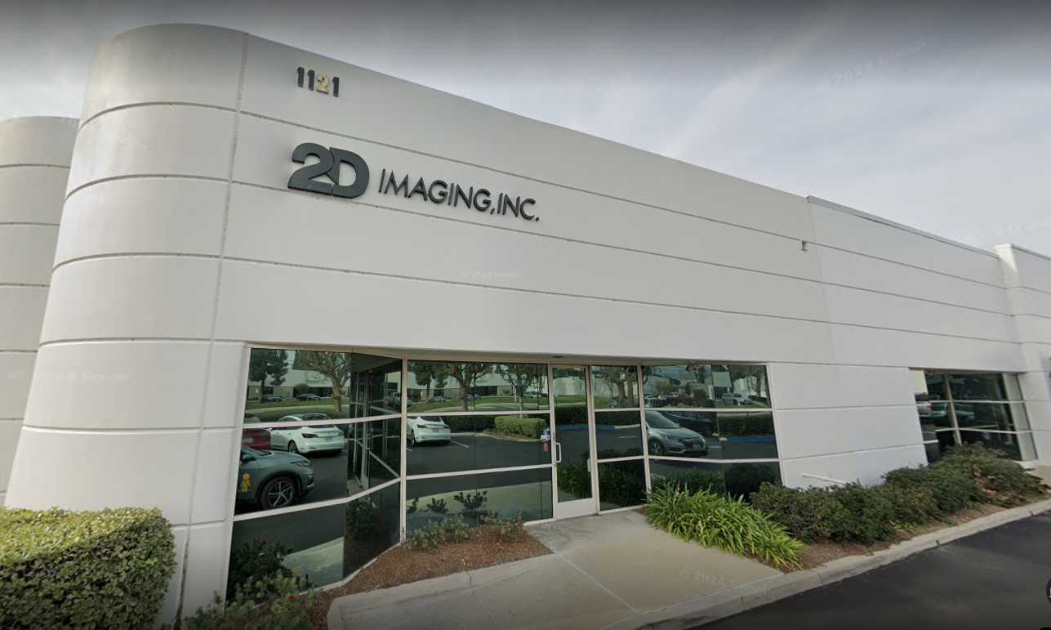

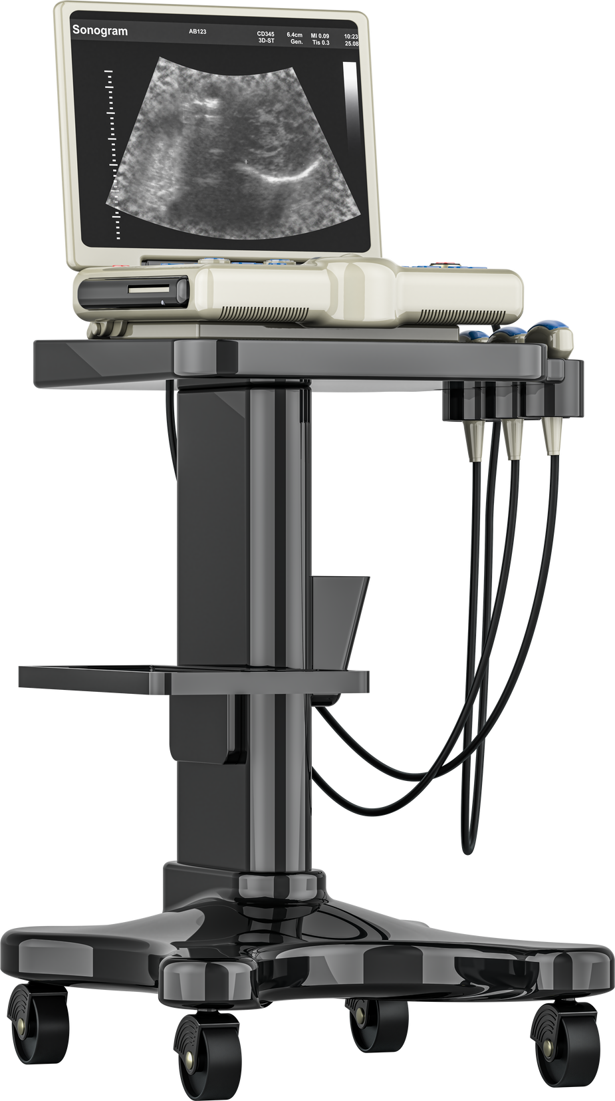
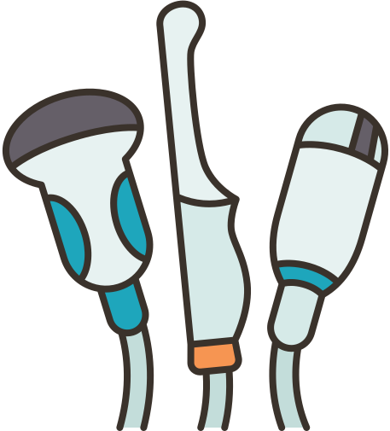
Our Client
2D Imaging, Inc. is a small, family-owned business specializing in medical ultrasound equipment sales, repairs, refurbishing, and servicing.
The company is currently expanding its e-commerce capabilities and online sales presence.
Highly specialized, expensive medical equipment requires good customer service
Customer support infrastructure for increased volume and diversity of inquiries
Goal
Develop a Question Answering (QA) system to provide accurate, timely, and relevant information to customers
Notes:
Our presentation starts in sunny southern california at 2D Imaging. 2D Imaging, Inc. is a small, family-owned business specializing in medical ultrasound equipment sales, repairs, refurbishing, and servicing. The company is currently expanding its e-commerce capabilities and online sales presence. However, a $5000 probe isn't exactly something you would add to cart and check out with your credit card. In this highly specialized medical equipment industry, where a single ultrasound machine can cost as much as a car, and even refurbished probes can run into the thousands of dollars, delivering exceptional customer service is not just a nice-to-have; it's an absolute necessity. Before making a purchase, customers would want to know if the probe they are buying works with the machine that they have. They want to know what condition the refurbished product is in. They want to know what applications it can be used for and how it compares to other models on the market.
As 2D Imaging expands into the global market, the company must adapt its customer service and support infrastructure to handle the increased volume and diversity of inquiries that come with this growth.
To address this challenge, our project aims to develop a sophisticated question-answering system that will enable 2D Imaging to provide accurate, timely, and relevant information to customers worldwide, ultimately enhancing the overall customer experience and supporting the company's global expansion efforts."

Slide 3
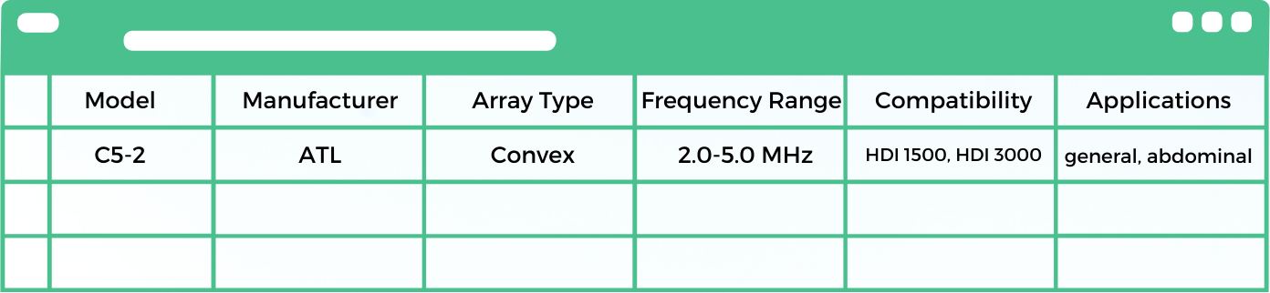
Preparing the knowledgebase
Loop through tabular data and transcribe into human-readable sentences
“The manufacturer of the C5-2 probe is ATL.”
“The ATL C5-2 is a convex array type probe.”
“The ATL C5-2 probe is compatible with the following systems: HDI 1500, HDI 3000.”
Final corpus contains 324 text documents
Notes:
The first step to creating our QA system is to create the knowledge base. This involves collecting, organizing, and preprocessing all the relevant information about 2D Imaging's products, including technical specifications and compatibility details for each of our products. Our knowledge base consists of tabular data containing ultrasound probe and system specifications such as the model name, manufacturer, stock, and compatibility. We used a python script to loop through rows and columns of the dataframe to create human readable sentences for each cell of data. For example, data under the manufacturer column were turned into sentences like “The manufacturer of the C5-2 probe is ATL.” and similarly for all the columns. This resulted in a final corpus of 324 documents where each document was a sentence containing a factoid about a specific probe.

Slide 4
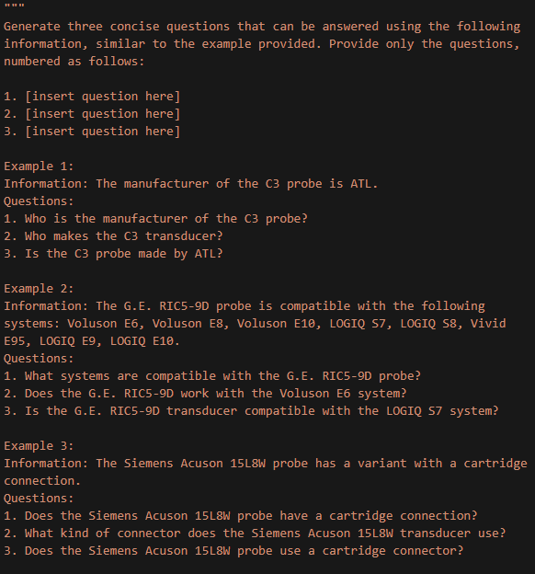
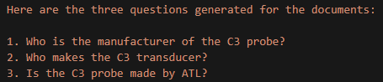
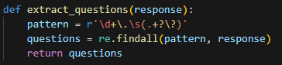
Generating Question-Document Pairs
Used large language model (Llama3) to generate 3 questions for each document
Prompt Engineering
Provide examples for each type of document
Provide clear instructions for parseable output structure (e.g. numbered list)
Notes:
Now that we have a well-structured knowledge base, the next step is to generate question-document pairs that our system can learn from. To accomplish this, we employed a large language model to generate three relevant questions for each document in our corpus.
To guide the model, we crafted a prompt template that provided examples of generating concise, answerable questions based on the information within each document. The questions could be open-ended or close-ended but had to be answerable using only the document's content.
To streamline the process of extracting the questions from the model's output, we incorporated a template in the prompt, instructing the model to respond solely with the questions structured as a numbered list.This is done to account for the variability in the language model’s responses, as we discovered that Llama3 doesn’t always perfectly follow directions and is still susceptible to hallucinations for this task. However, as long as it remembers to number each generated question, we were able to utilize regular expressions in Python to extract only the questions, filtering out any unnecessary text.
For example, the language model would preface its response with “Here are the three questions generated for the documents” before listing out the three questions. So we created a regex function that looked for a sequence of a number followed by a dot, whitespace, and then captured the text until the first question mark.
This allowed us to parse the output and map each question onto its corresponding document in our training dataset.

Slide 5
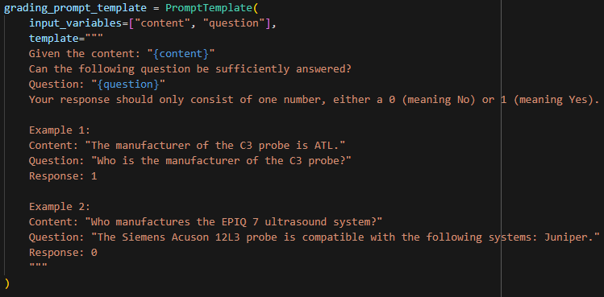
Generating Question-Document Pairs
Used llama3 to filter out poorly generated question-document pairs
Any question-document pairs marked as irrelevant were manually reviewed
Final dataset: 932 queries, 324 documents
Notes:
After we generated queries for our documents, we then used llama3 again to help us filter out any poorly generated question-document pairs.
Below is the prompt we used for this process.
Any question-document pairs that were marked as irrelevant were manually reviewed and rescored if necessary.
The final dataset of query-document pairs consisted of 932 queries that correspond to 324 documents

Slide 6
Evaluating Pre-trained Models
all-mpnet-base-v2
multi-qa-mpnet-base-dot-v1
multi-qa-distilbert-cos-v1
General-purpose model based on the MPNet architecture
Trained on diverse corpus of 1B+ sentences
https://huggingface.co/sentence-transformers/all-mpnet-base-v2
mpnet-base model fine-tuned using 215M question-answer pairs
https://huggingface.co/sentence-transformers/multi-qa-mpnet-base-dot-v1
Fine-tuned using 215M question-answer pairs
Based on the DistilBERT architecture, which is a lighter and faster version of the popular BERT model
https://huggingface.co/sentence-transformers/multi-qa-distilbert-cos-v1
Evaluation Metric:
Mean Reciprocal Rank (MRR)
Documents ranked based on their cosine similarity scores to the query
Calculates reciprocal rank (1/rank) of the “correct” document
Notes:
In the next step of building our question-answering system, we focused on selecting an appropriate embedding model. Embedding models convert text data into numerical representations, enabling the system to understand and compare the semantic meaning of words and phrases. The best-performing out-of-the-box model will be fine-tuned with our query-document dataset.
We tested three models from Hugging Face: 'all-mpnet-base-v2', 'multi-qa-distilbert-cos-v1', and 'multi-qa-mpnet-base-dot-v1'. 'all-mpnet-base' is a general-purpose model, while the other two were trained on a question-answer dataset of 215 million pairs. 'multi-qa-distilbert-cos-v1' is based on the DistilBERT architecture, which uses knowledge distillation to create a smaller, faster model. 'multi-qa-mpnet-base-dot-v1' uses the MPNet architecture, which employs masked and permuted language modeling.
To evaluate the models' performance, we used the Mean Reciprocal Rank (MRR) metric. Documents are ranked based on their cosine similarity scores with respect to the query embeddings, with more semantically similar documents receiving higher scores and ranks. MRR calculates the average reciprocal rank (1/rank) of the first relevant document retrieved for a set of queries, making it particularly useful when there is only one relevant document per query, as it focuses on the position of the first correct result.

Slide 7
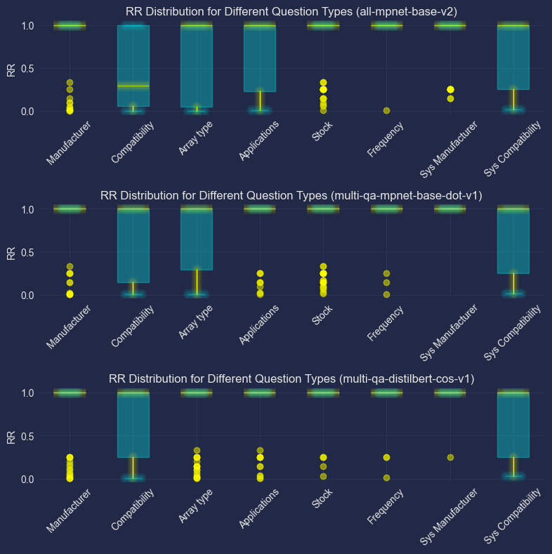
Distribution of Reciprocal Rank Scores by Question-type and Embedding Model
Notes:
Upon examining the distribution of reciprocal rank scores, we observed that the generalized model, 'all-mpnet-base', exhibited a higher spread in RR scores across more question type categories compared to the other two models. In contrast, both question-answering models, 'multi-qa-distilbert-cos-v1' and 'multi-qa-mpnet-base-dot-v1', performed consistently well across all categories of questions. This is evident from their median reciprocal rank scores being 1 for all categories, indicating that the first relevant document was often ranked at the top position.

Slide 8
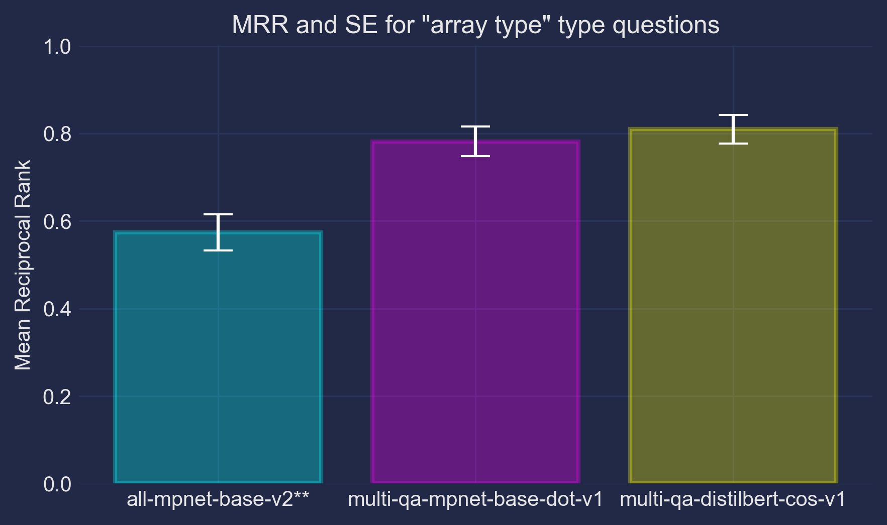
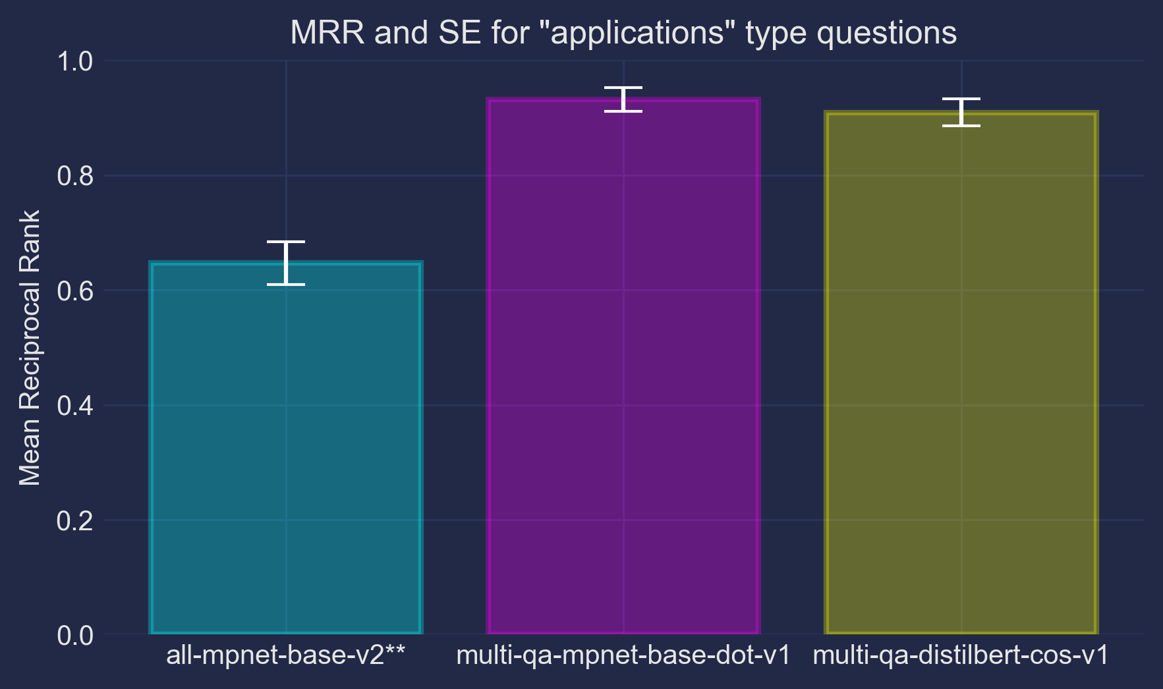
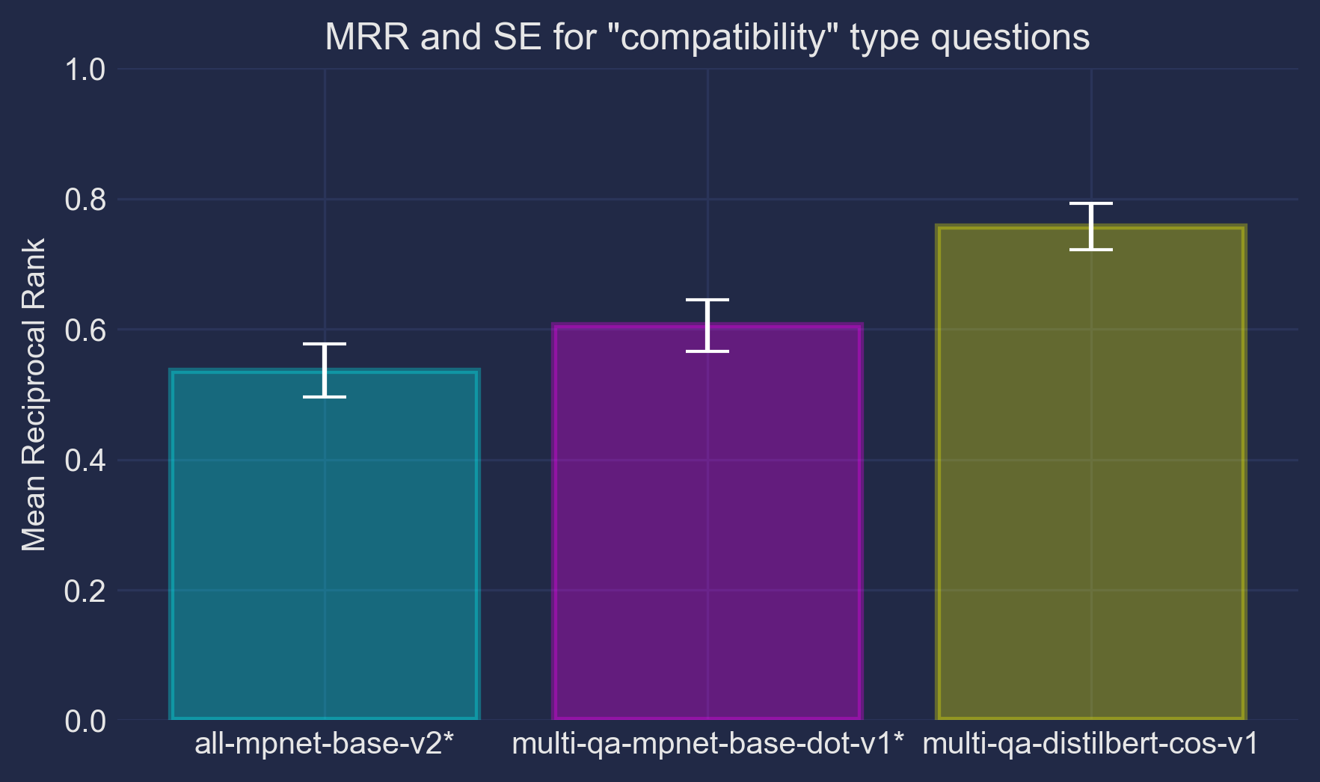
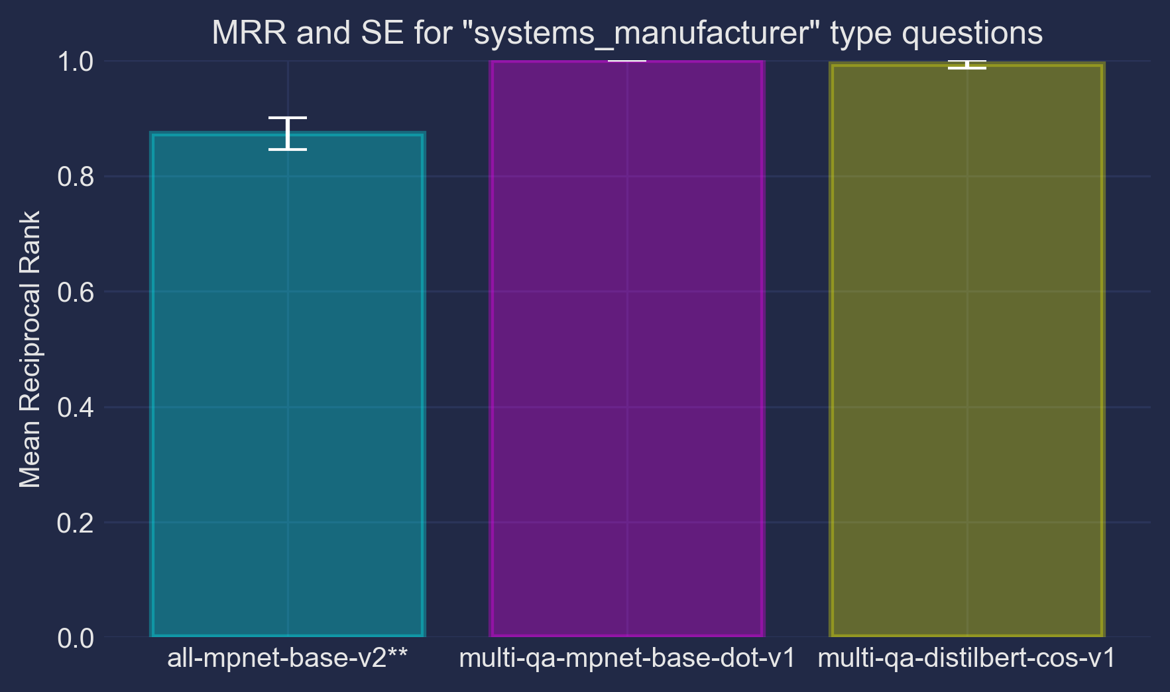
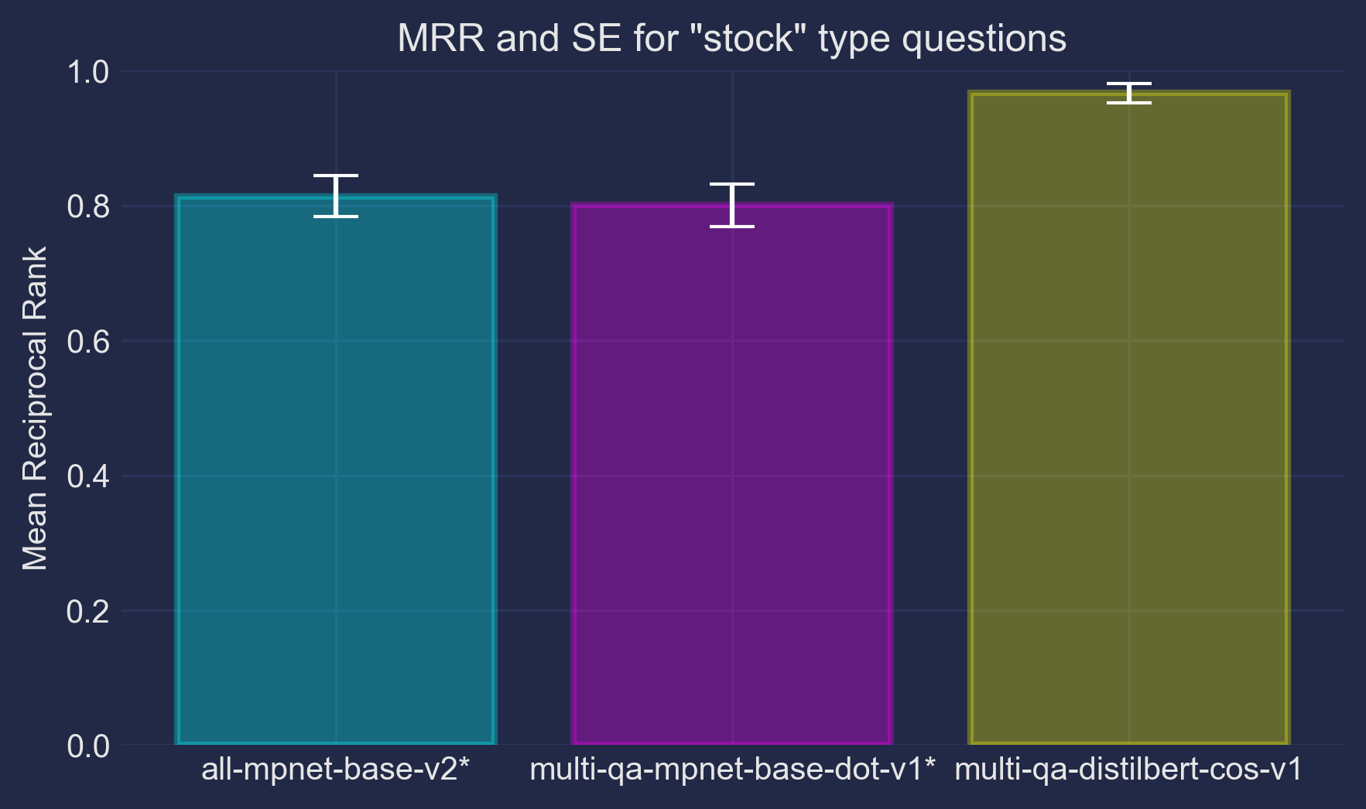
Mean Reciprocal Rank and SE across Various Question Categories
Notes:
As part of our analysis, we employed Tukey's Honest Significant Difference test to assess the significance of performance differences between the embedding models. The test revealed that in 5 out of 8 question categories, the comparisons were statistically significant.
The results consistently highlighted a notable trend: the generalized model yielded statistically lower scores across multiple categories compared to the two QA models. Furthermore, the QA distilbert model demonstrated impressive performance, consistently achieving equally high, if not the highest, MRR scores across all question types.
This information will guide our decision-making process as we select the most suitable embedding model, which is multi-qa-distilbert, for our question-answering system and focus our efforts on fine-tuning and optimizing its performance.

Slide 9
Hyperparameter Tuning
Base model: multi-qa-distilbert-cos-v1
Create training/validation/testing (70/15/15) PyTorch Datasets
Bayesian Optimization for hyperparameter tuning
per_gpu_batch_size: (16, 64)
weight_decay: (0, 0.3)
learning_rate: (1e-5, 5e-5)
warmup_steps: (0, 500)
num_epochs: (2, 5)
→ 56
→ 0.21
→ 3.6e-5
→ 106
→ 4
Notes:
To fine-tune our selected embedding model, the QA distilbert model, we created a custom PyTorch Dataset class that takes in query-document pairs and split our data into 70/15/15 train/val/test sets
Bayesian optimization was employed to find the optimal hyperparameters for fine-tuning. This approach aims to maximize the Mean Reciprocal Rank (MRR) metric on the validation set by intelligently searching the hyperparameter space. The search space for the Bayesian optimization focused on these 5 hyperparameters
The optimization process ran for 15 iterations with 5 initial points. The best hyperparameters found were:

Slide 10
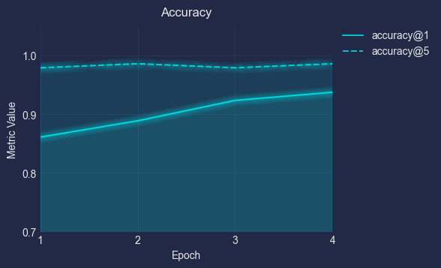
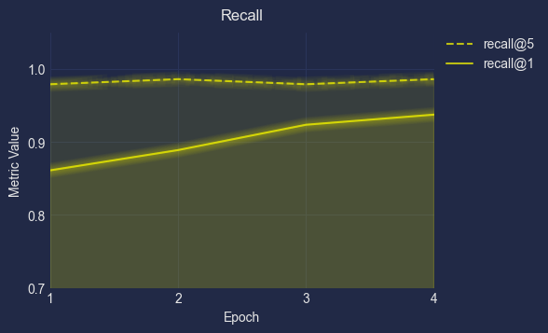
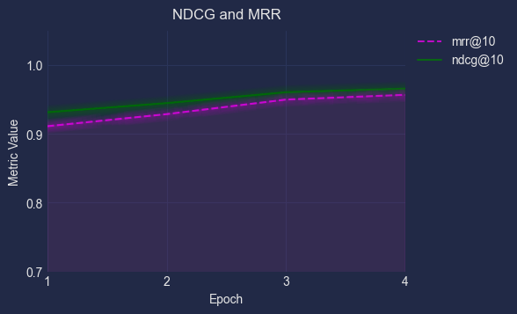
Fine-tuning (training)
Loss function: MultipleNegativesRankingLoss
Designed for training models with only positive pairs of data (e.g. query, relevant document)
Minimizes negative log-likelihood of softmax-normalized similarity scores
Performance metrics collected at different top-k values (e.g., @1, @5, @10)
Accuracy, Recall, MRR, NDCG (Normalized Discounted Cumulative Gain)
Notes:
We utilize the MultipleNegativesRankingLoss function which is ideal for training retrieval models where we have only positive pairs of data, such as (query, relevant document) pairs. For each query-document pair in our batch, the loss function treats the actual pair as positive and all other pairs in the batch as negatives.
So how this loss function works is first it calculates the cosine similarity scores between the query and document pairs. The similarity scores are then normalized using the softmax function, transforming them into a probability distribution. Then the loss function minimizes the negative log-likelihood of these softmax-normalized scores which encourages the model to assign higher probabilities to the relevant documents and lower probabilities to the irrelevant ones.
During training, we monitor several performance metrics to evaluate the effectiveness and progress of our model. We track these metrics at different top-k values (e.g., @1, @5, @10) to understand how well the model performs at various levels of retrieval depth.
Accuracy measures the percentage of queries for which the relevant document is among either the top 1 or top 5 retrieved documents.
Recall measures the percentage of relevant documents that were successfully retrieved among the top-k results.
Normalized Discounted Cumulative Gain is a measure of ranking quality that considers not only the relevance of the retrieved documents but also their positions in the ranked list, with more weight given to higher positions.
MRR is the average of the reciprocal ranks of the first relevant document for each query, considering only the top-k results.

Slide 11
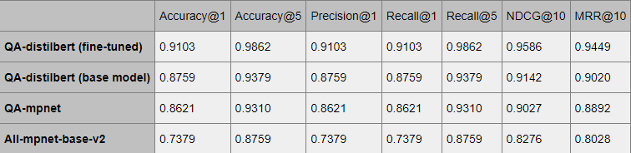
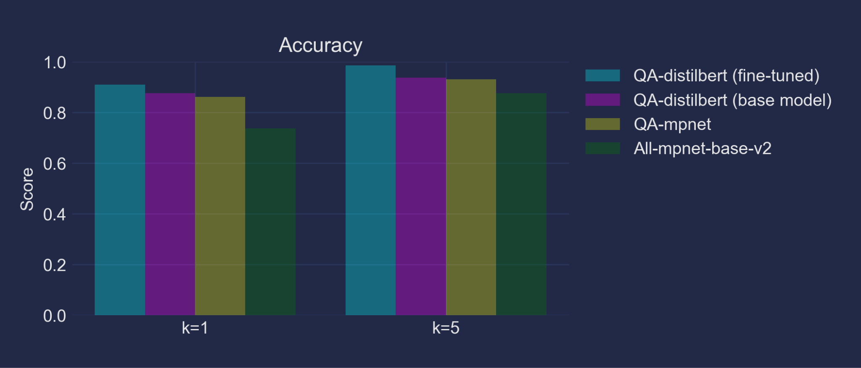

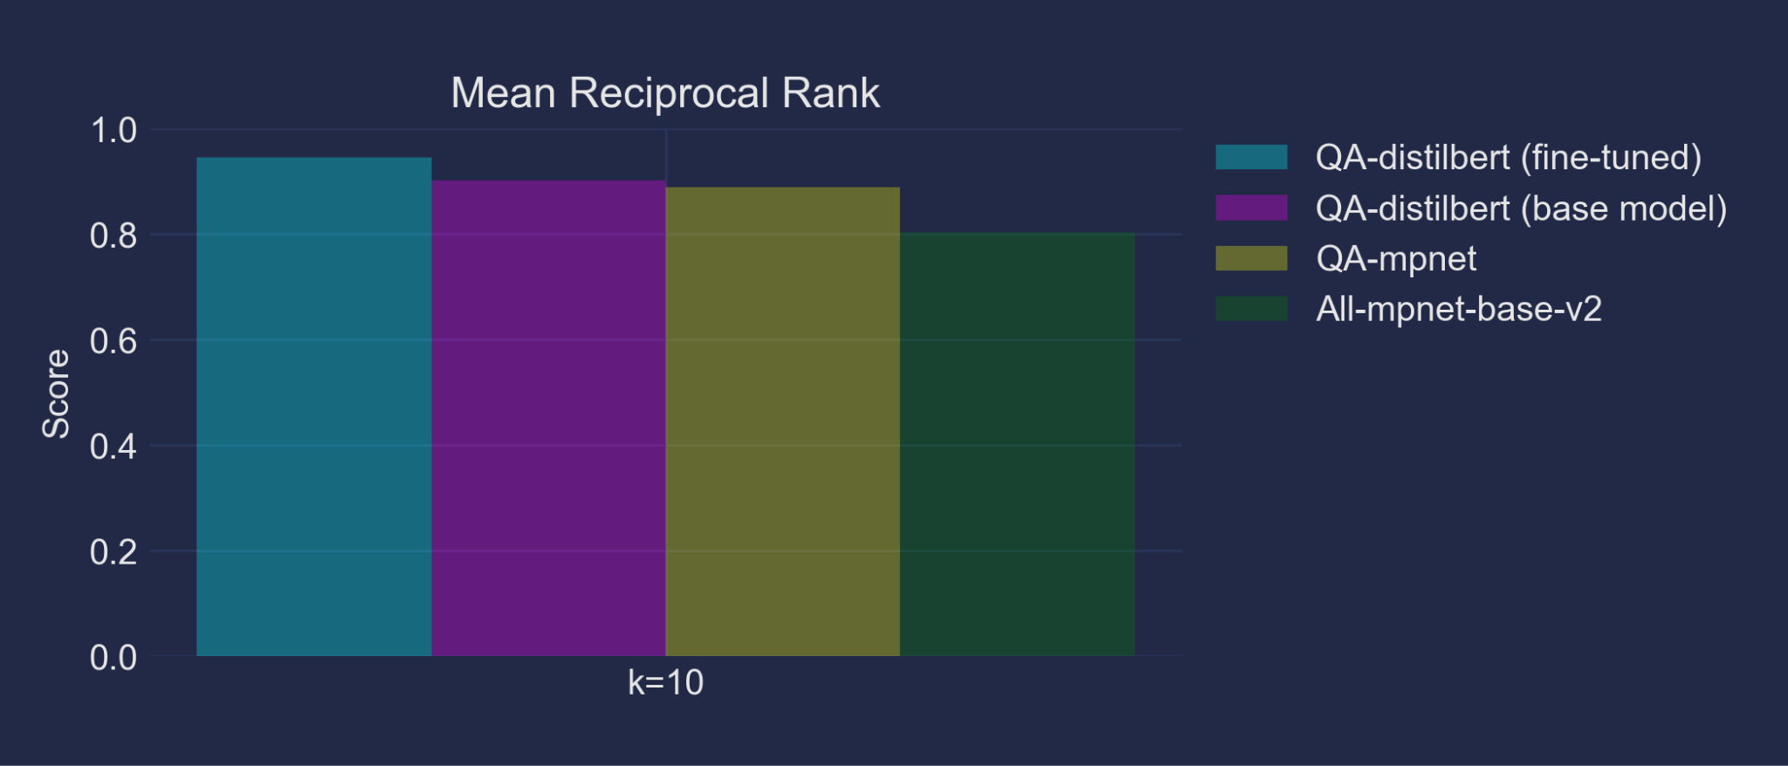
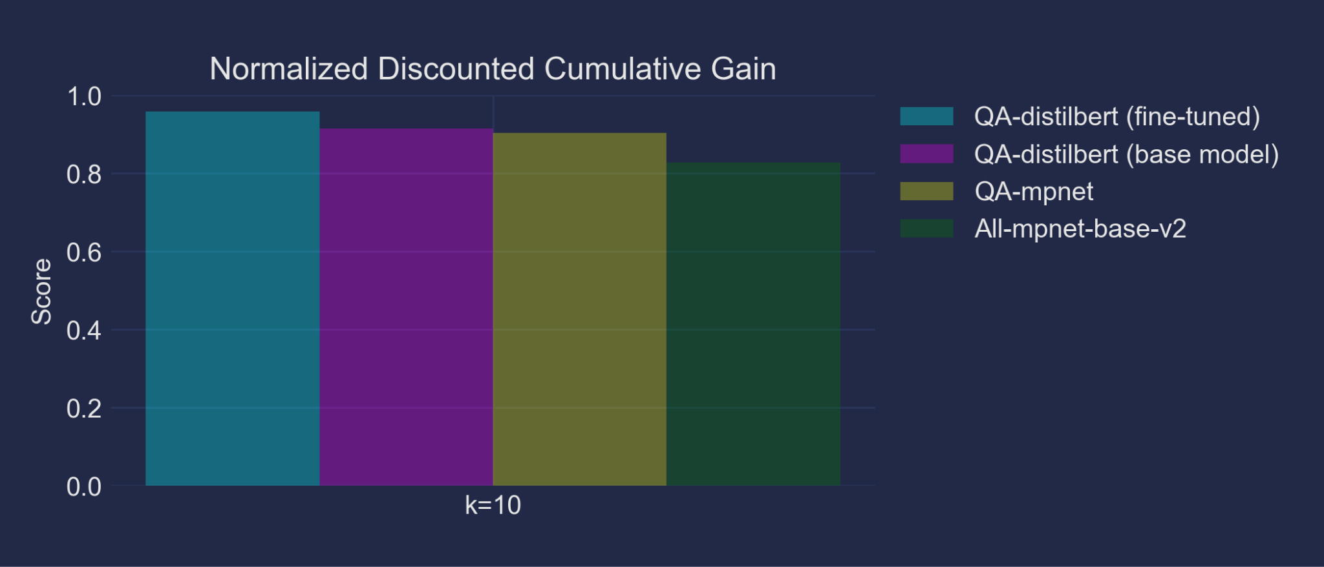
Model Evaluation and Comparison
Notes:
After training the final model with the best hyperparameters, its performance was evaluated using a holdout test set and compared against three other models: the pre-trained multi-qa-distilbert-cos-v1, multi-qa-mpnet-base-dot-v1, and all-mpnet-base-v2.
In all of the performance metrics, the fine-tuned DistilBERT model consistently scored the highest, followed by the pre-trained base model (multi-qa-distilbert-cos-v1), then the multi-qa-mpnet-base-dot-v1 model, and finally the all-mpnet-base-v2 model.
These results demonstrate that while the pre-trained base model (multi-qa-distilbert-cos-v1) performed well out-of-the-box, its performance was further improved by fine-tuning it on our company's dataset. The fine-tuning process allowed the model to adapt to the specific domain and characteristics of our data, leading to superior performance compared to the other models.

Slide 12

Summary
1
Create the document knowledge base
2
Generate queries for each document using LLM
3
Evaluate pre-trained embedding models
4
Bayesian Optimization
5
Fine-tuning
6
Evaluate
Notes:
In summary, we were able to successfully develop and fine-tune a QA System by first, converting our tabular data into text documents. And then we generated queries for each document using a language model. We then evaluated several embedding models to decide on the best performing one, multi-qa-distilbert-cos-v1. Then we implemented bayesian optimization for hyperparameter tuning. Using the best hyperparameters we trained our best performing embedding model and then evaluated it against the performance of the other 3 pre-trained models.

Slide 13
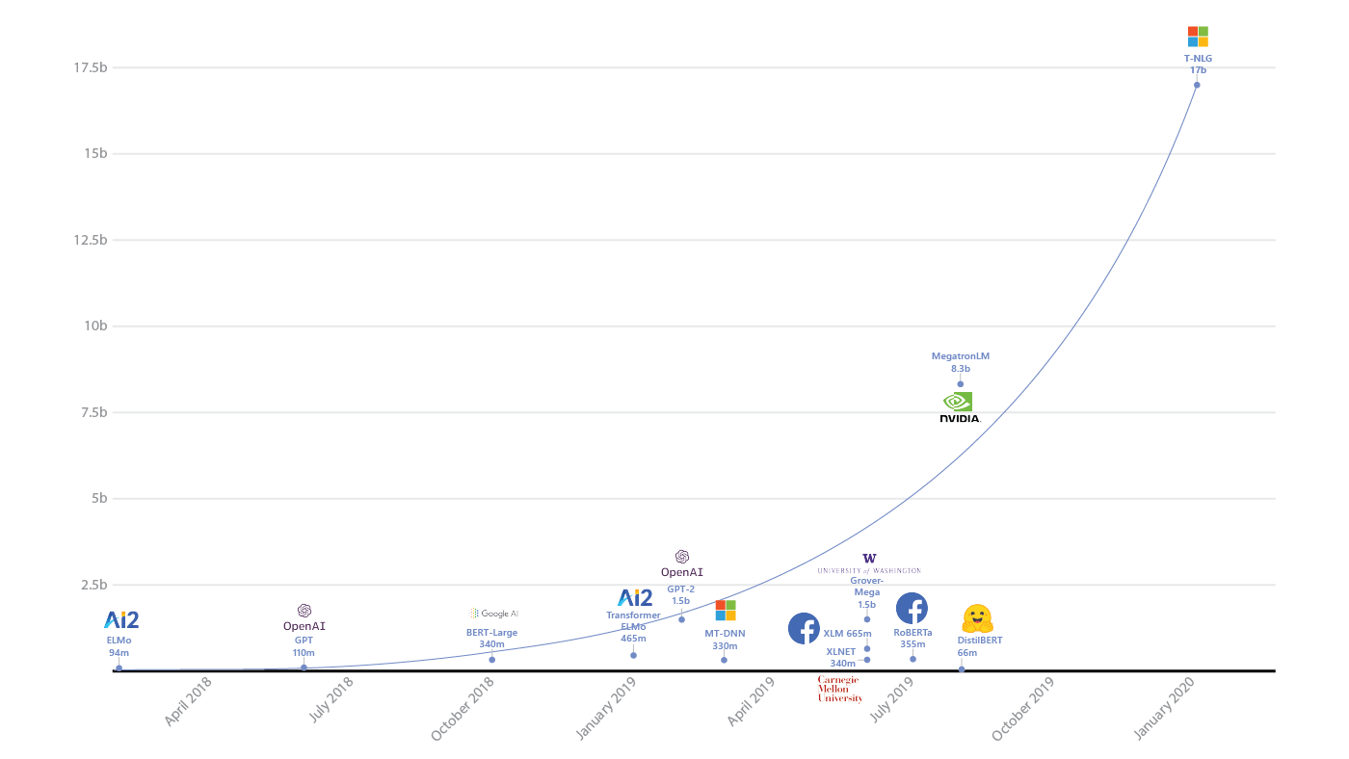
Concluding Remarks
DistilBERT’s size makes it a practical choice for customer support systems
Generated queries are relatively simplistic (required only one document to formulate an answer)
Expand QA system to retrieve multiple relevant documents and LM to synthesize a response
Integrate LM chains with structured database queries
Notes:
A notable strength of the distilbert model is its compact size, with only 66 million parameters. This is considerably smaller than many other large language models, which can have billions of parameters. Despite its compact size, the fine-tuned DistilBERT model outperformed larger models in our QA task. The reduced model size offers advantages in terms of computational efficiency, memory requirements, and deployment costs, making it a practical choice for real-world applications like customer support systems.
A potential limitation of the current system is that the generated queries are relatively simplistic, requiring only a single relevant document to formulate an answer. In reality, more complex customer inquiries may necessitate retrieving and combining information from multiple documents to provide a comprehensive response. To address this, future work could explore expanding the QA system to retrieve multiple relevant documents and leverage a language model to consolidating information from various sources and generate final answers.
Another intriguing direction for future work would be to integrate language model chains with structured database queries. This approach could involve using language models to generate SQL code that directly queries various data tables within the company's database, and retrieving the required information to formulate a response to customer inquiries. This method could potentially provide answers to even more complex questions, while also enabling the QA system to update as the underlying data sources evolve.
Overall, this project demonstrated the potential of leveraging natural language processing and machine learning techniques to enhance customer support processes. Our approach can be extended to other domains and industries as a low-cost and effective solution for question-answering systems.

Slide 14

Any questions?

